Slide 1
Cuse-Alumni-Groves
By: Harshitha Reddy Kancherla

Slide 2
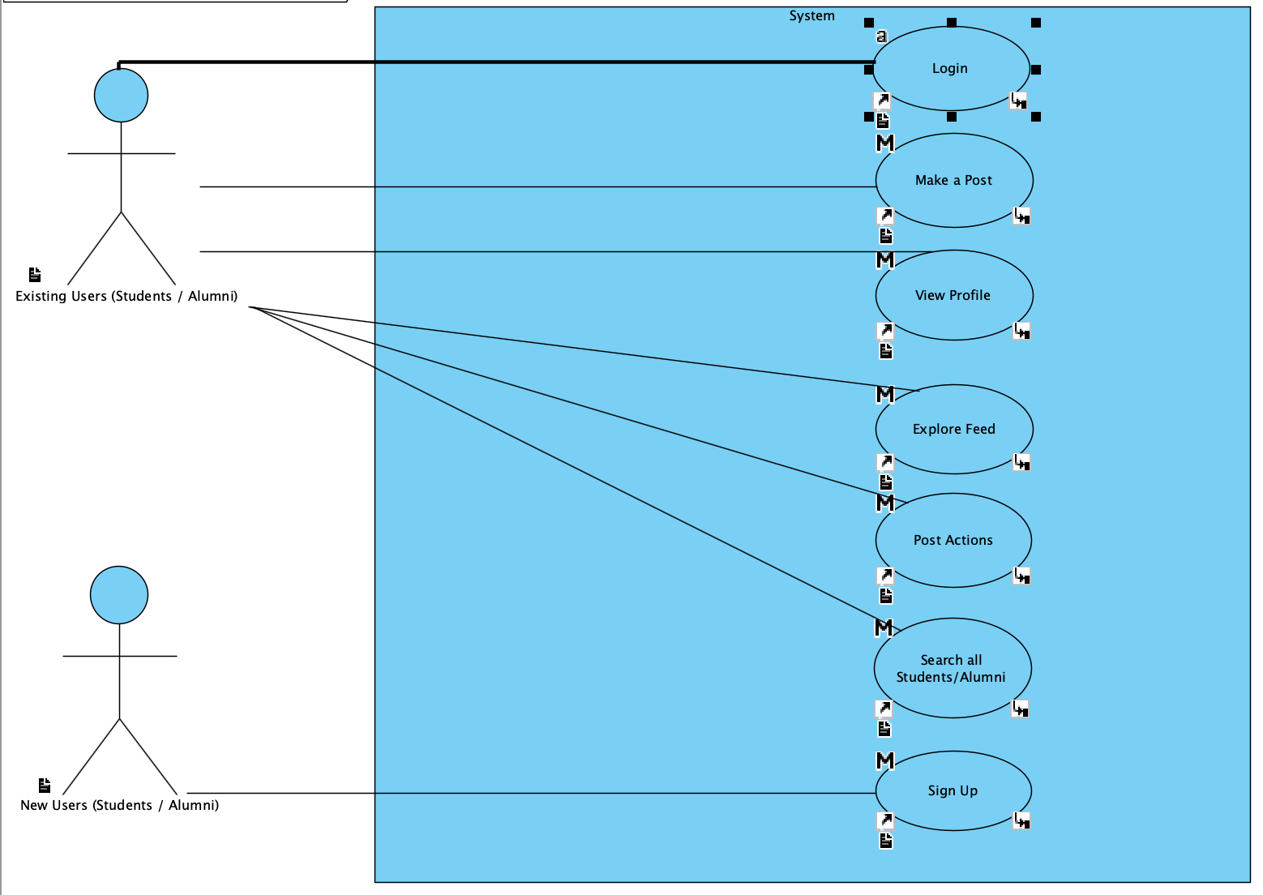

Slide 3
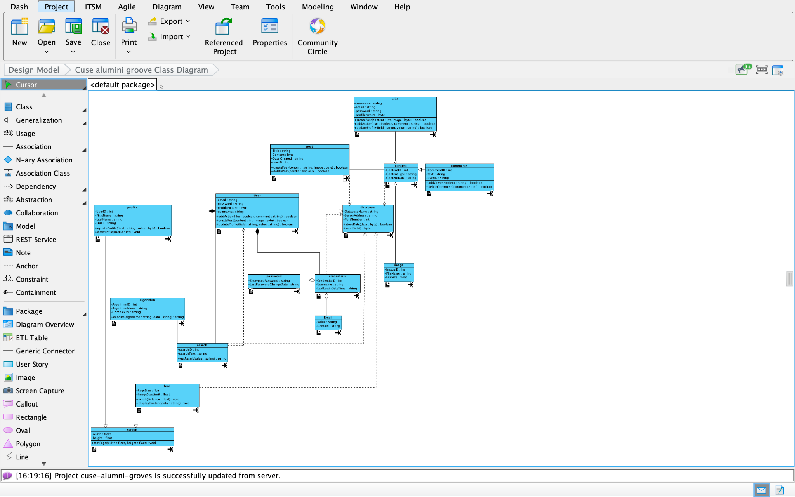

Slide 4
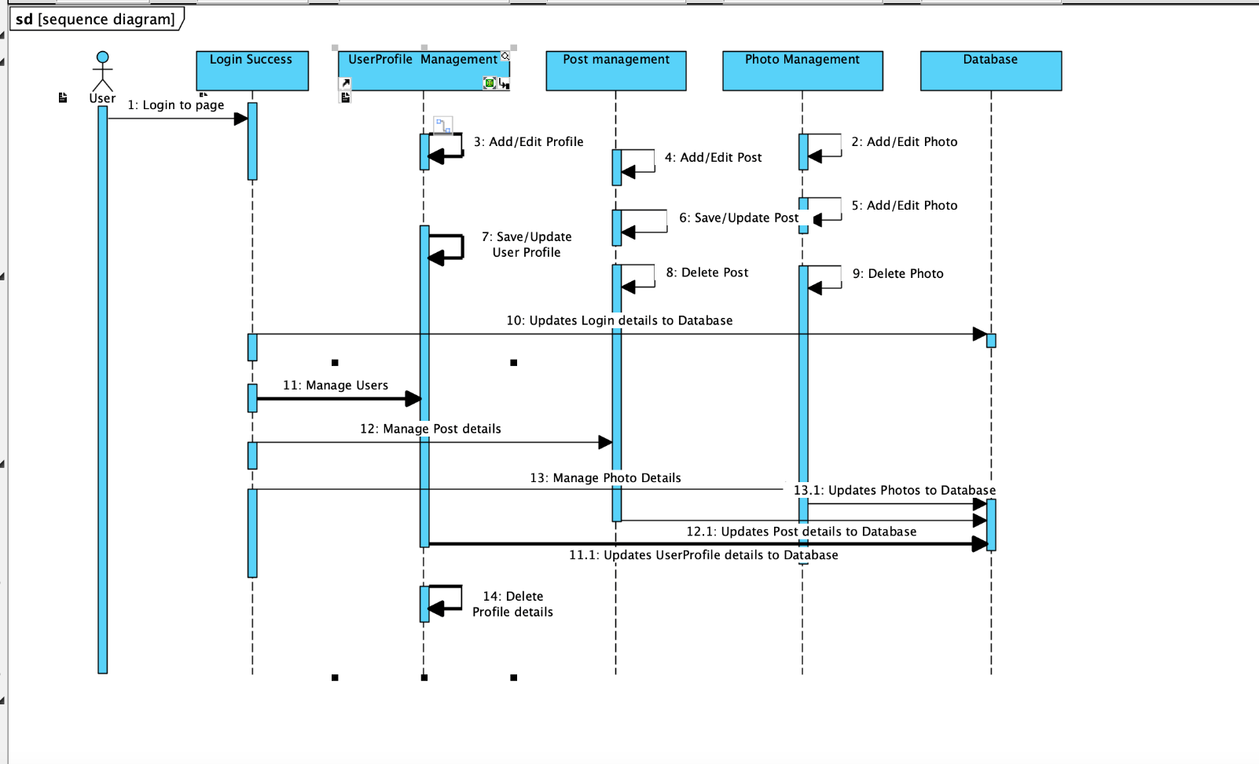

Slide 5
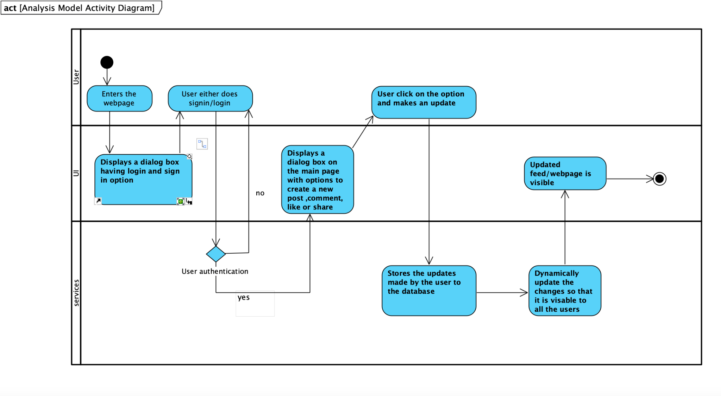

Slide 6
